Slide 1
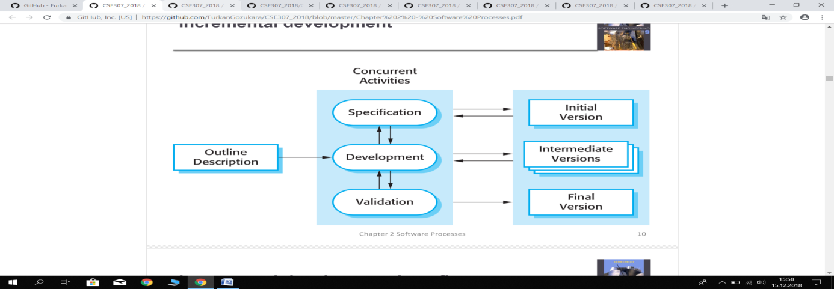
Concurrent Activities
Visual Studio
User
Login
Access
User
Variable
User

Slide 2
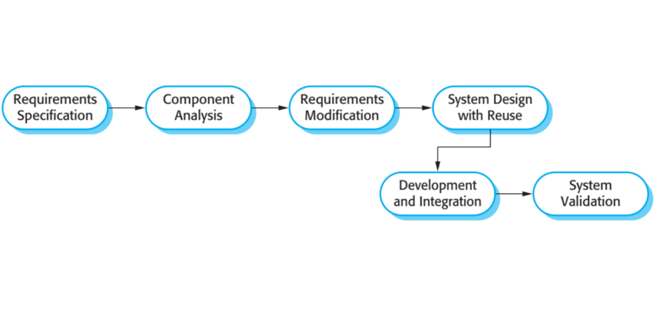
Student Add-Remove
Access
Login Analysis
User
Student and Parents
Kindergarten Member

Slide 3
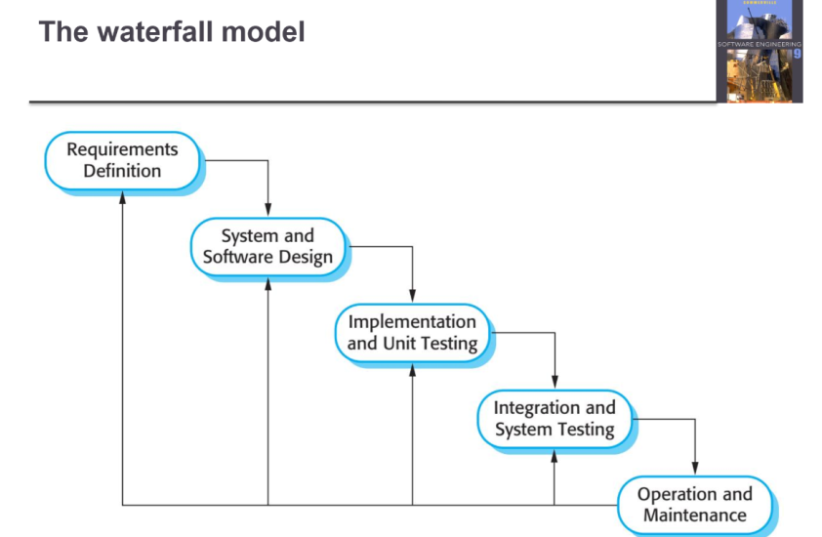
Student Add
Access and Viusal Studio
Student Check
Parents Check
FullForm

Slide 4
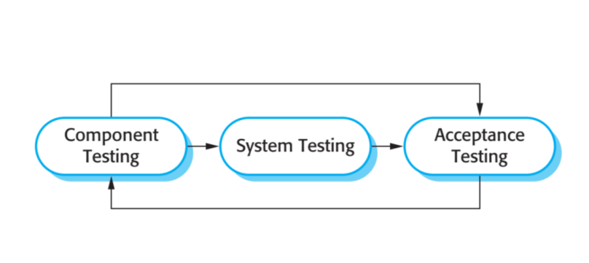
Login
User login provided or User input not provided
User accepted
Not accepted

Slide 5
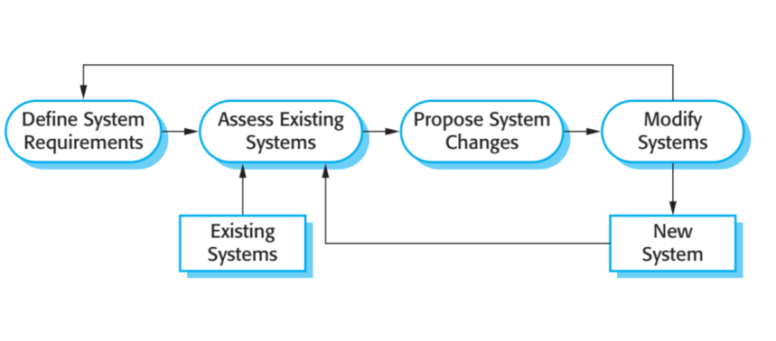
Kindergarten Automation
Login
Student Check
Student Check
Closed Application
New Student

Slide 6
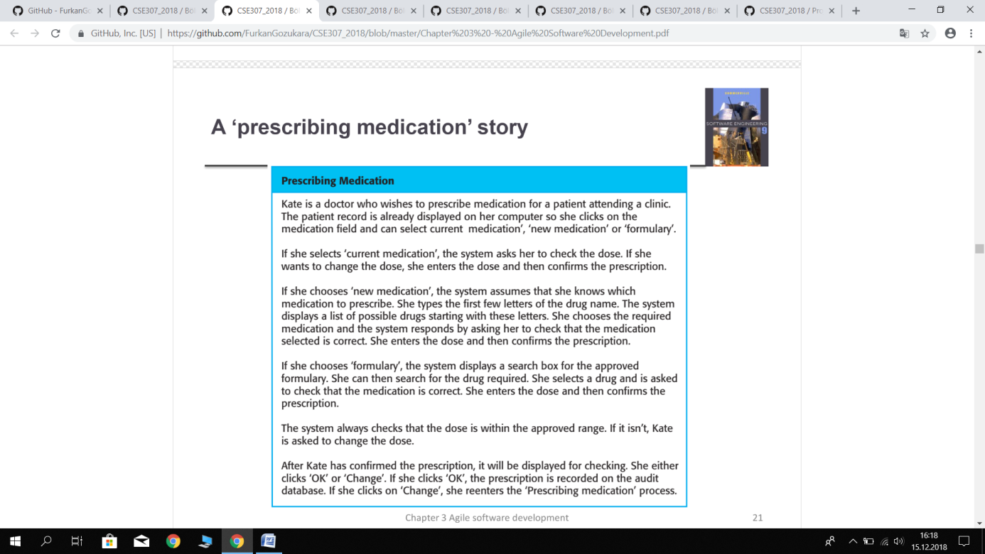
Private kindergarten project starts with login and then opens the main form. This button has buttons that go to the form which form you want to go.
Kindergarten automation

Slide 7
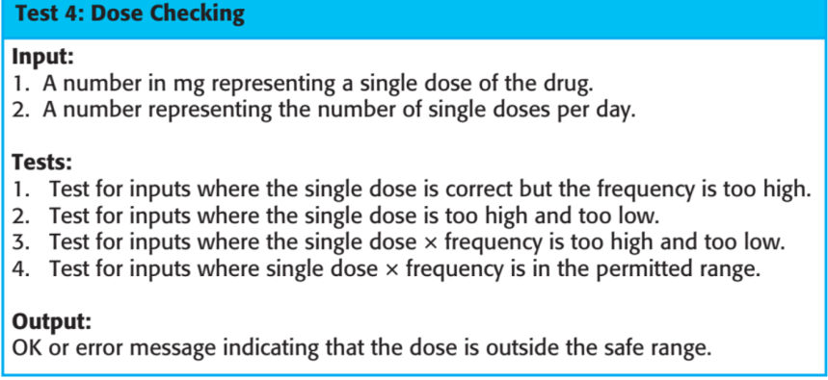
Input:
The database is used in the control of our project.
2) Database is controlled by switching
Test:
1) Database control is required to be done in the form.
Output:
If the test result is correct, the test is successful.
Test 4:Checking

Slide 8
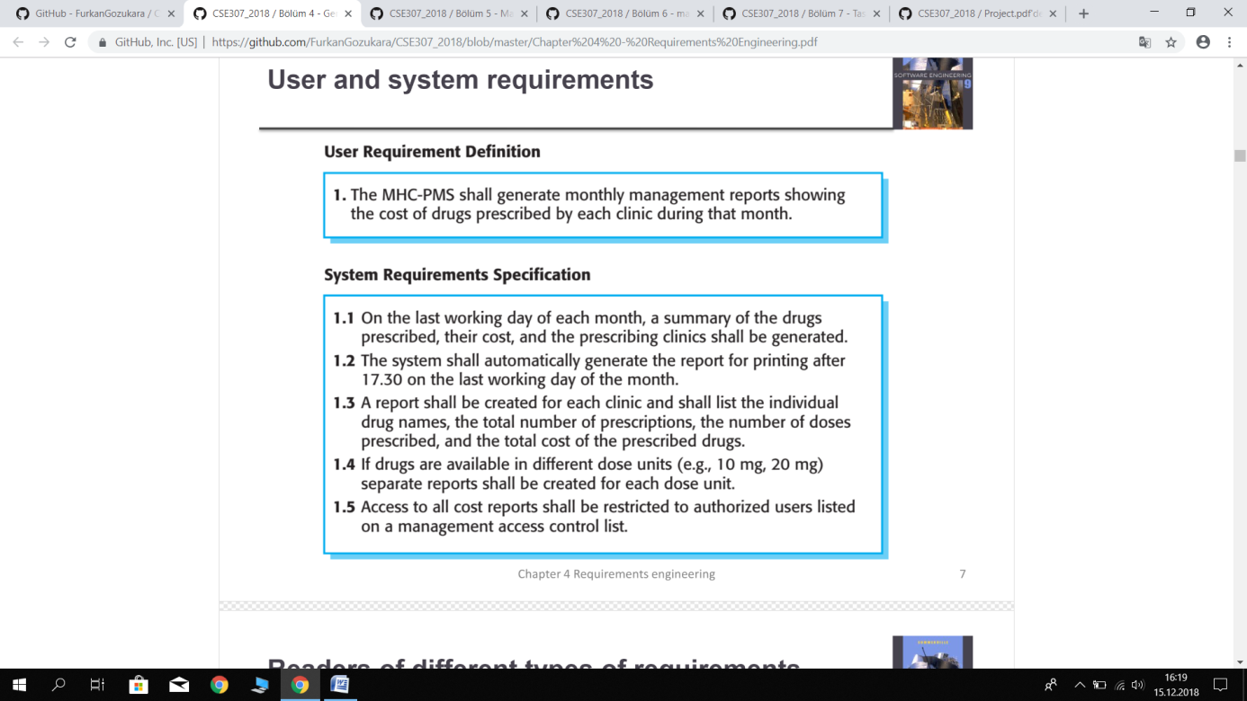
User Requirement Definition
1) Login with user name surname and password and information in the database.
System Requirement Specification
To provide access to the form on the basis of the information available in the database.

Slide 9
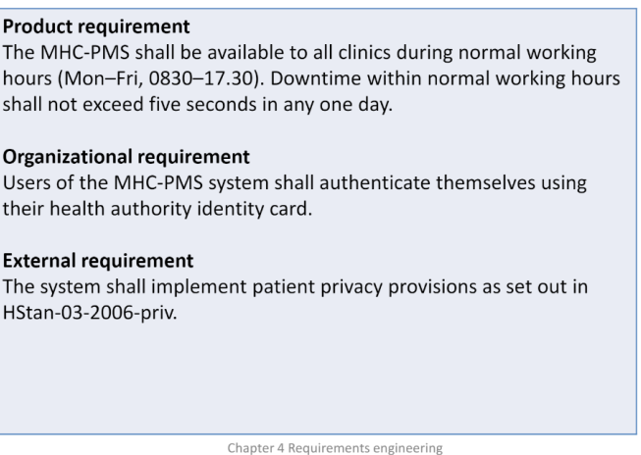
Product requirement
Visual studio and microsoft access and c#.
Organizational requirement
In order to use the private kindergarten project, there must be a certain number of students and the right to be admitted.
External requirement
It is necessary to understand the external requirements to use the project and project training.Dış gereksinimleri ise projeyi kullanmak için anlamak lazım olması ve proje eğitimi.

Slide 10
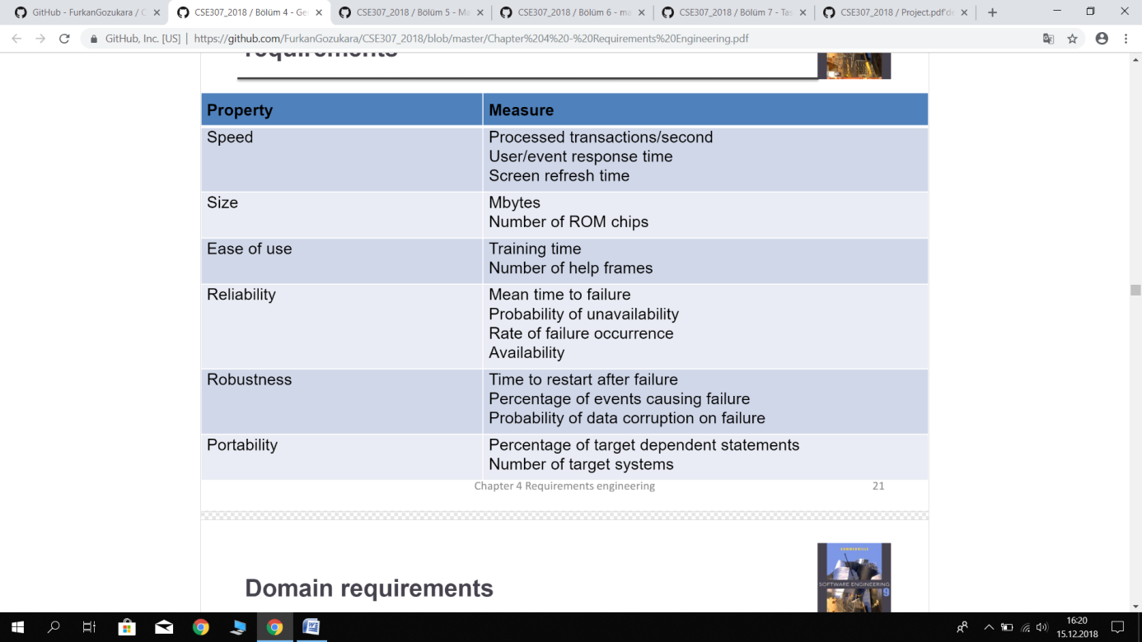
Property | Result
Speed | User response time
Size | Mbytes
Ease of use | Automation
Reliability | Availability, Presence of login screen
Robustness | c sharp writing with language and automation
Portability | It is portable with flash memory.

Slide 11
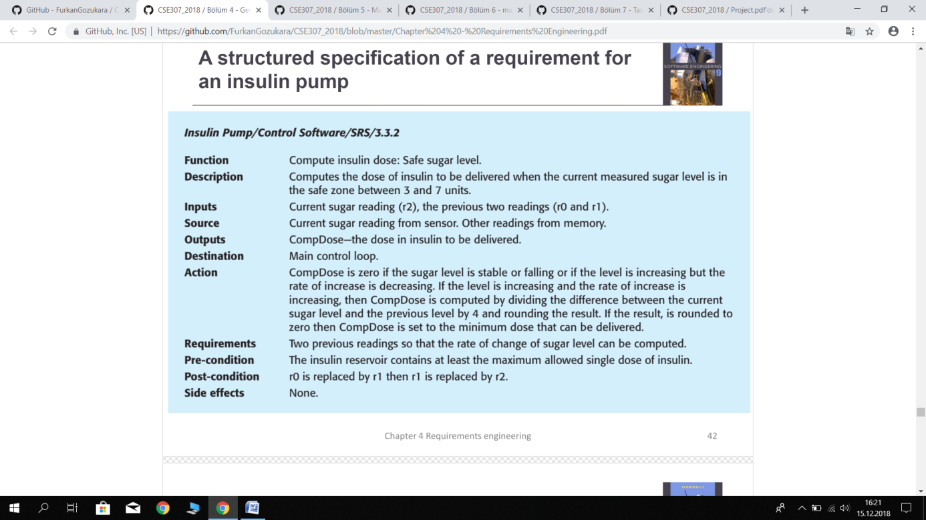
Function
Number of students
Description
The students in the form are checked how many students are on the button.
Input
Source
Outputs
Destination
Action
The database is used in the control of our project.
Access database
If the test result is correct, the test is successful.
Main control loop
It becomes available after the automation is activated and activated.
The requirements for kindergarten automation will first use the automation after the student after the parent user.
Requirements
Pre-condition
Purchase project

Slide 12
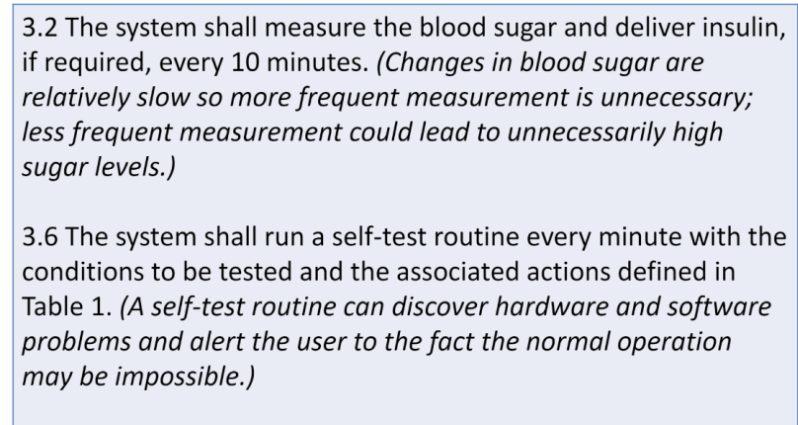
3.2 As an example, the student should be a student for joining.
3.6 As an example, you will be enrolled so that the student registration is not deleted.

Slide 13
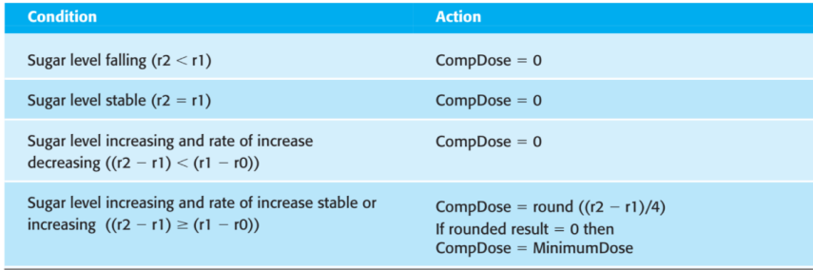
Condition | Action
Login true | User true
Login false | User false
Project owner | Usable
Project not owner | unusable

Slide 14
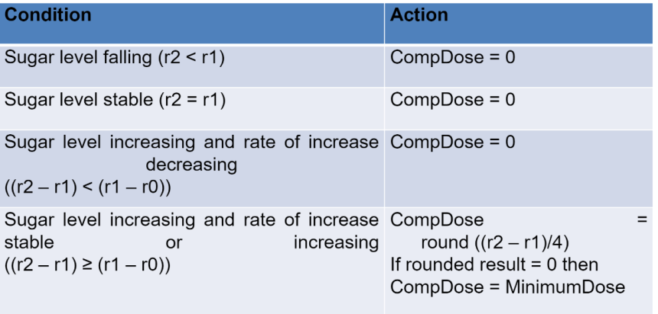
Condition | Action
Student Add | add after login screen
Student Not Add | if the student does not follow the rules
User Add | add before database or Access
User Not Add | if the user does not follow the rules

Slide 15
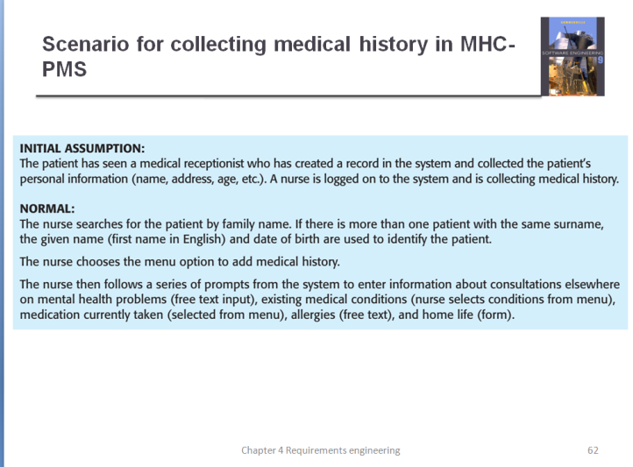
SCENARİO:
In order to add a student, first login must be logged in, and if login is correct, then the form is changed and the desired actions are performed.
If desired, the student is added or deleted. Students are checked in. The registration status of the students is checked and the payment status is checked.

Slide 16
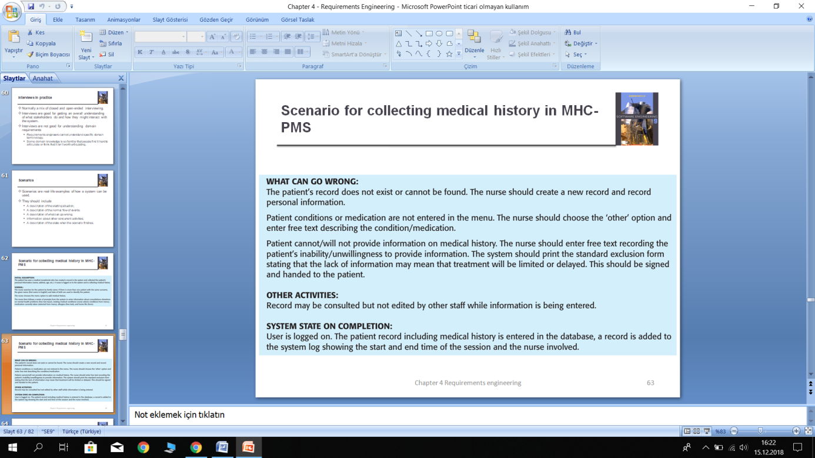
WHAT CAN GO WRONG:
Login may be incorrect, so input is not provided. Adding students with incorrect information can be done.
OTHER ACTIVIES:
There are explanations about why we should go to kindergarten and information about kindergarten.
SYSTEM STATE ON COMPLETION:
When the project is finished, all situations need to work and there should be no login error.

Slide 17
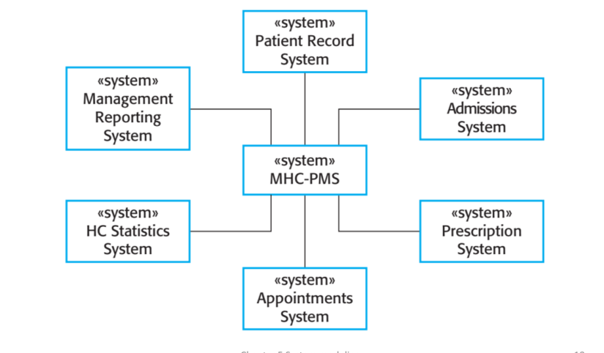
<system>
Tables
<system>
Variable
<system>
Login
<system>
Access
<system>
Full Form
<system>
Visual Studio
<system>
Relationships

Slide 18
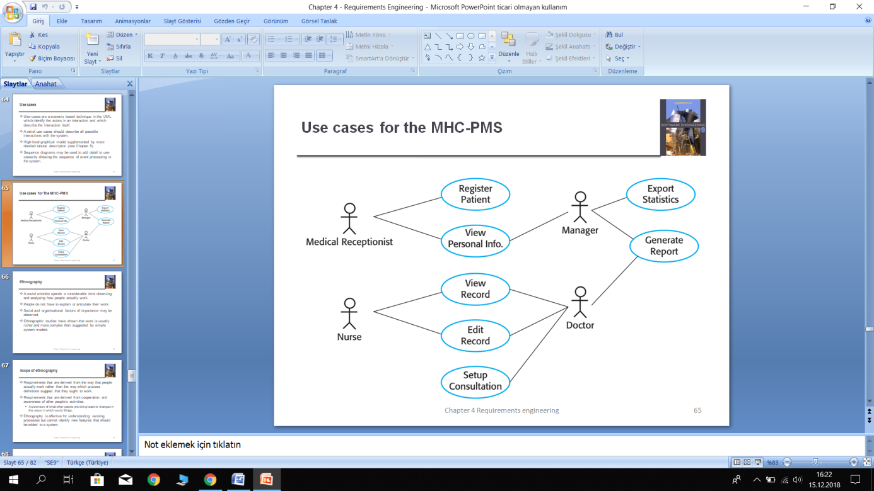
Added
Student Situtaion
Student
Student
Info
User
Student
Add
Check
View
Add Student
View Student Info
New User
New Student
Create
Student

Slide 19
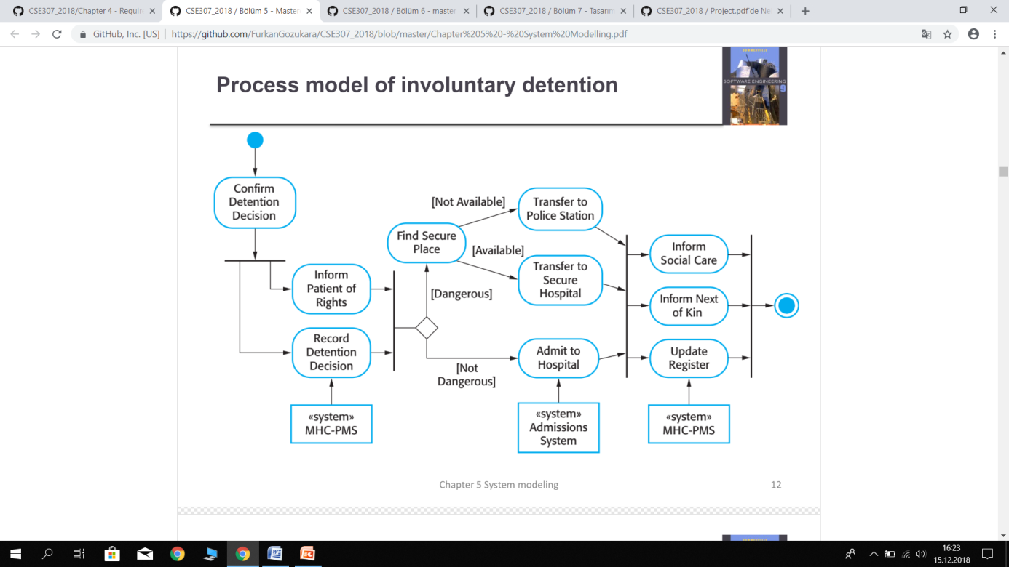
Transfer to kindergarten
[Not Available]
Find Student access
Inform student
Login
[Available]
Transfer to
kindergarten
Student information
Inform next of parents
[dangerous]
Student record
Update
user
User
[Not dangerous]
<system>
Student
<system>
Student
<system>
User system

Slide 20
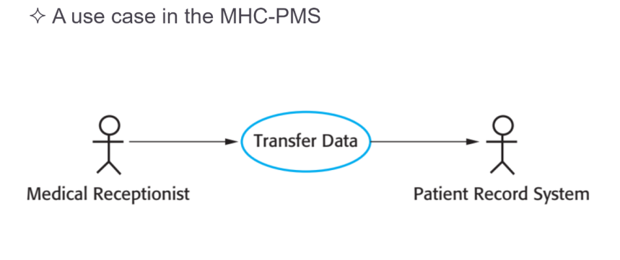
Add
User
Student

Slide 21
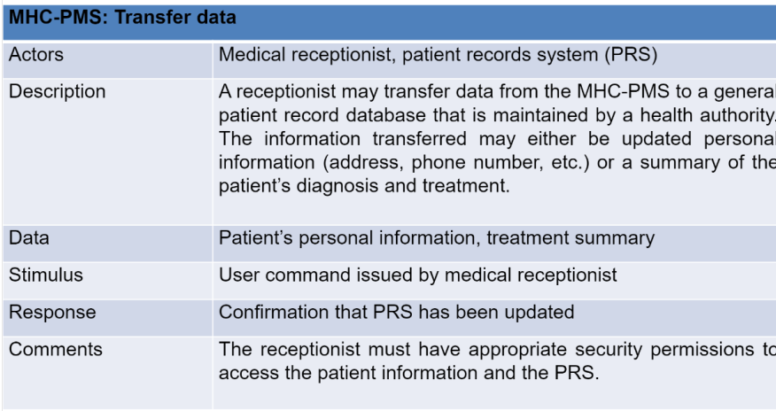
Student Add
Actors | Student,User,Parents
Description | Student Added,User Occupation,Parents Student Family
Data | Student Added, Kindergarten student list summary
Stimulus | Convenient project that provides convenience
Response | Students are registered or not registered
Comments | Access tables

Slide 22
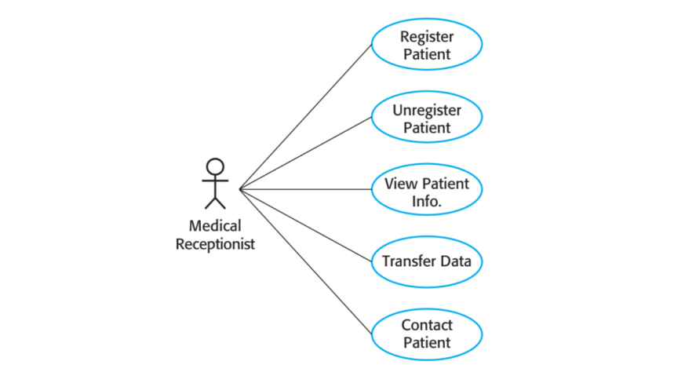
Login
Student Info
Student Add
User
Parents Add
Full Form

Slide 23
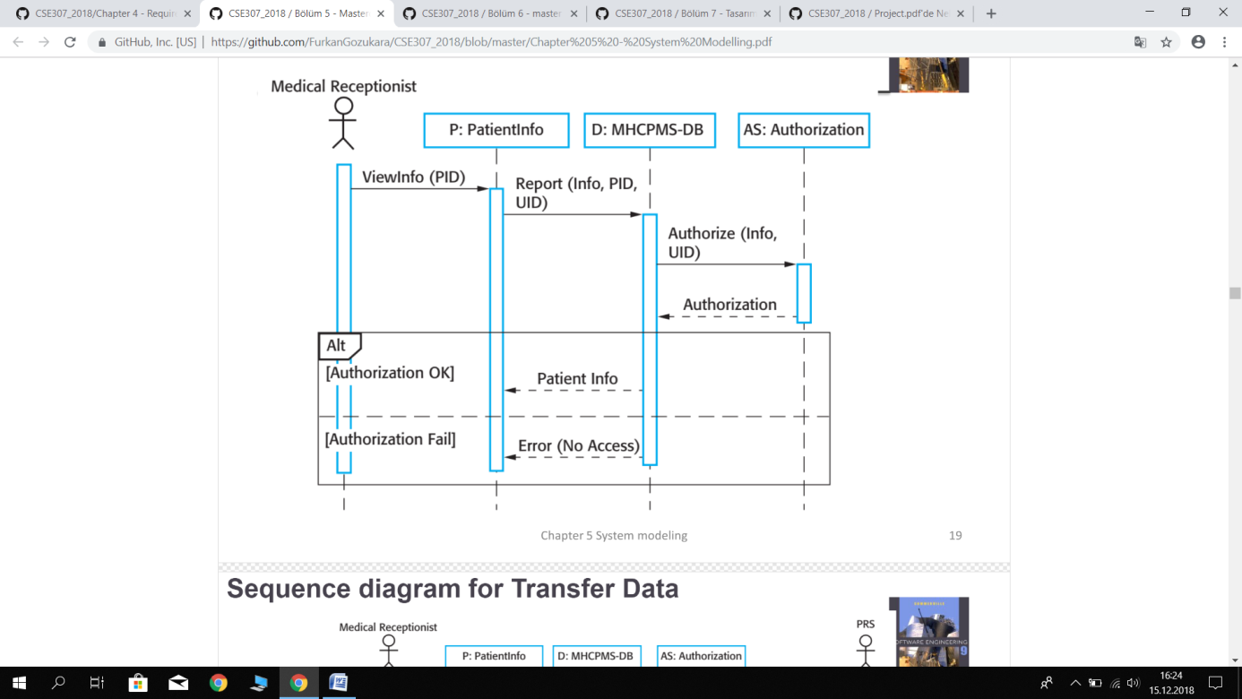
User
Student Info
Student
Autohorizaiton
View Info(User)
Check(Student Add)
Autohorizaiton(Info Student)
Autohorization
Alt
Autohorization(OK)
Student Info
Autohorization(Fail)
Error(No Access

Slide 24
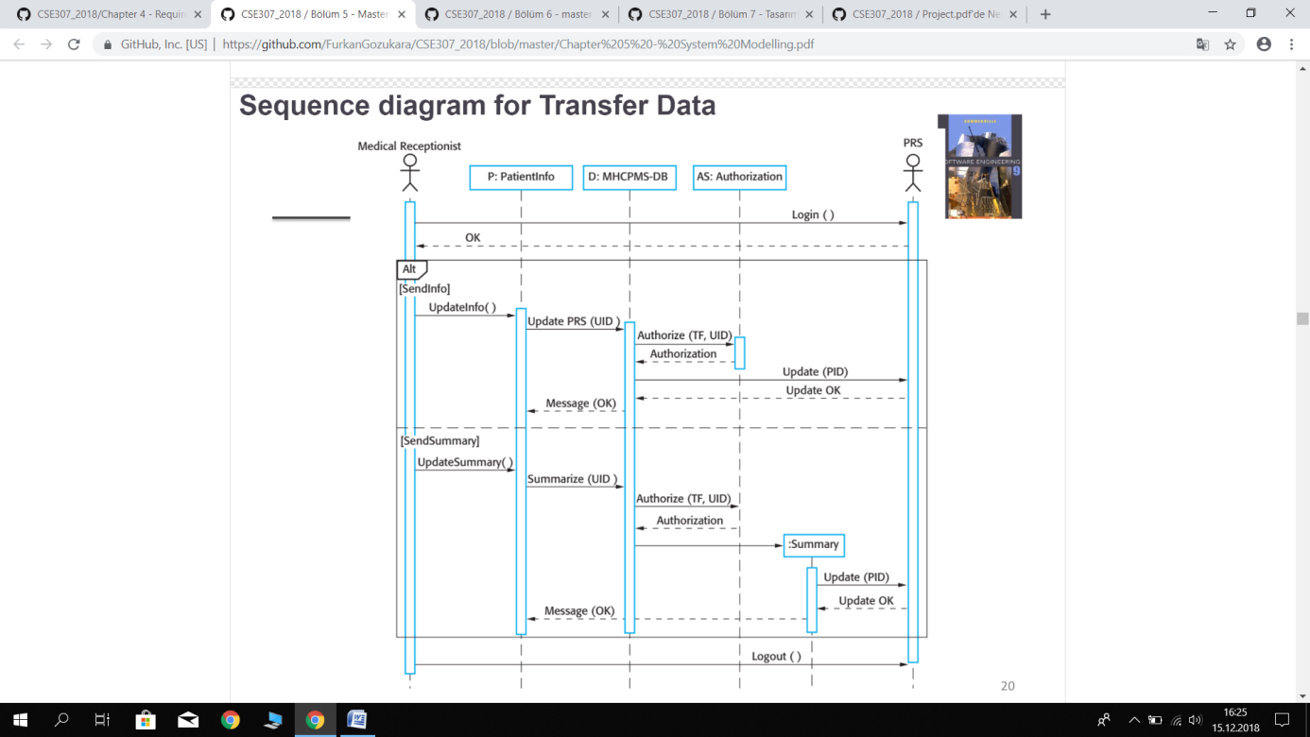
User
Student
user
parents
Student
login
OK
Alt
[sendinfo]
Update info()
Update(User)
Authorization
(Student)
Authorization
Message(OK)
Update OK
[sendsummary]
Update summary()
Authoriation
(Student)
Summarize()
Authorization
Summary
Update
(Parents)
Update
OK
Message(OK)
Logout()

Slide 25
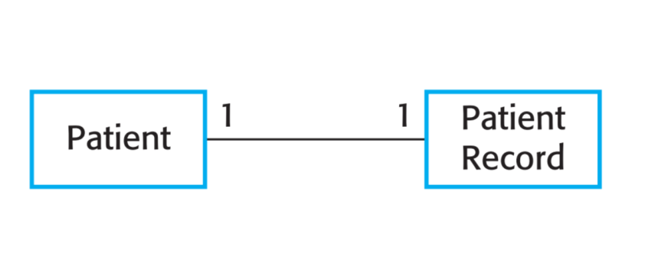
User
1
1
Student Add

Slide 26
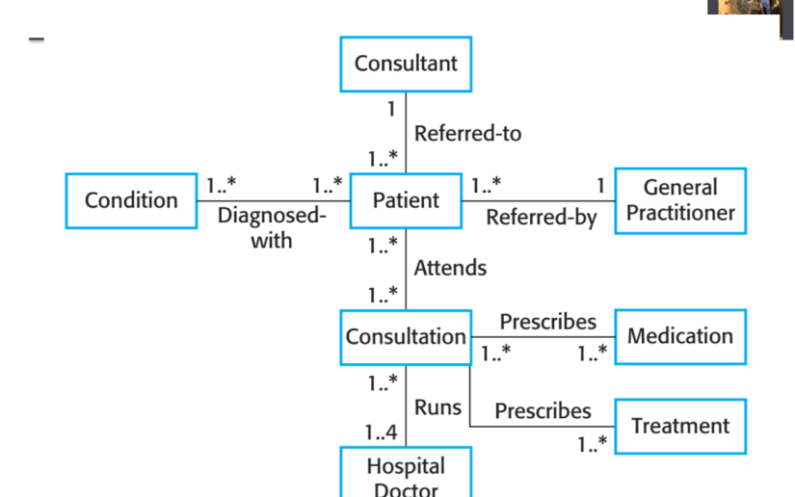
User
1
Referred -to
1..*
Add
1..*
1..*
Student
1..*
1
User
Diagnosed
with
Referred-by
1..*
Attends
1..*
Consultation
Prescribes
User by Student Records
1..*
1..*
1..*
Runs
1..4*
Parents
Conditions for registration are discussed
Prescribes
1..*

Slide 27
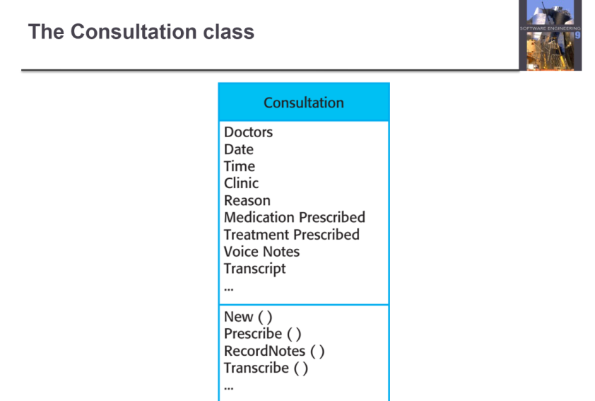
Consultation
Student
Date
Time
Class
Reason
User
Parents
Check
Student Add()
Record Situtaion()
Check()
…

Slide 28
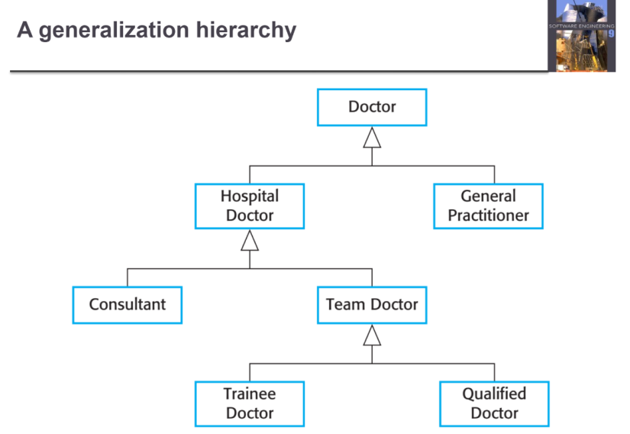
Student
User
General User
Parents Add
Student Add
User 1
User 2

Slide 29
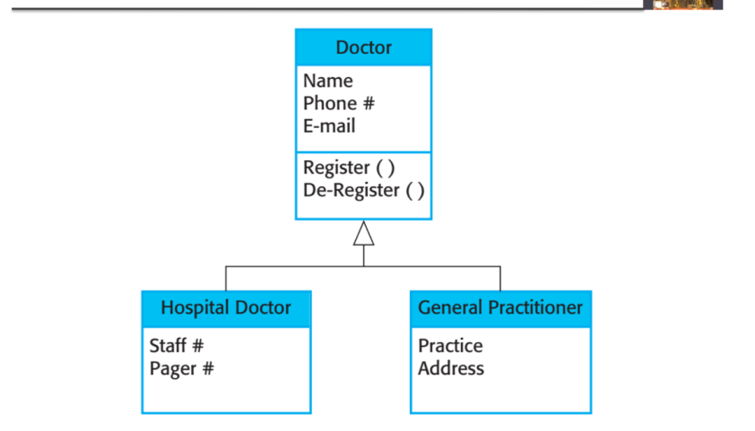
-Name
-Surname
-Parents -Name/Surname
Student
Student Added
-User name
-password
-installment check
-Student name/
surname check
General User

Slide 30
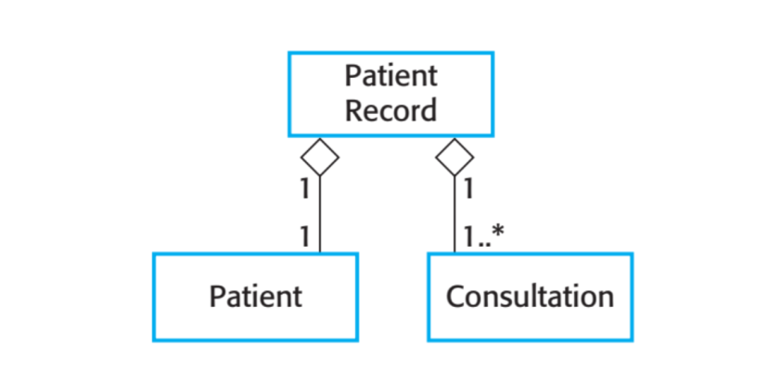
Student Record
1
1
1
1..*
Student
User

Slide 31
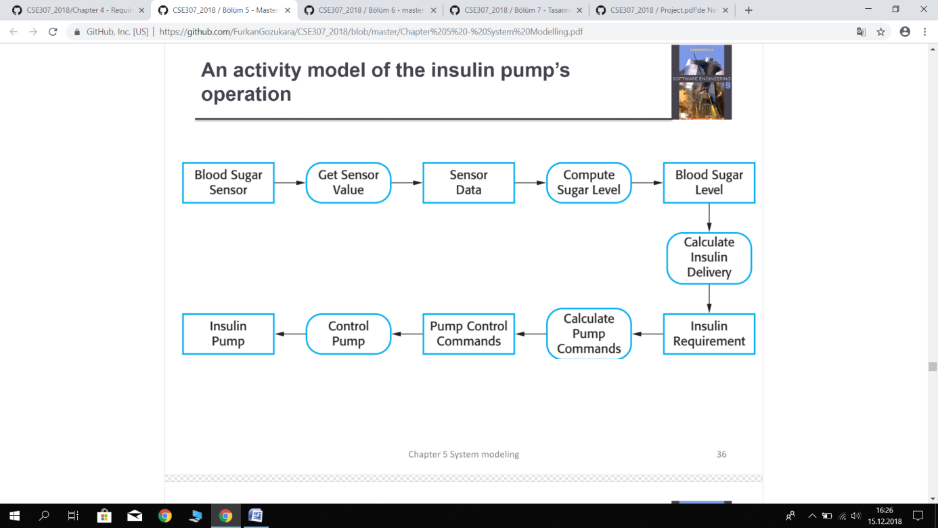
Number of students
Student registration order
Student Add
New Student
Access Data
calculate the number of students
Student
Requirement
Student Added
Control Student Form
Rules Commands Control
Rules Commands

Slide 32
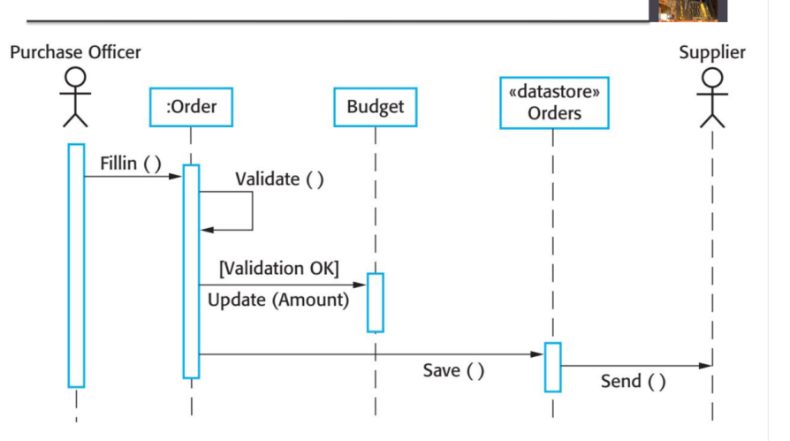
User
student
User name
password
New user add
Information()
Valiable()
[Validation OK]
Update(login)
Save()
Send()

Slide 33
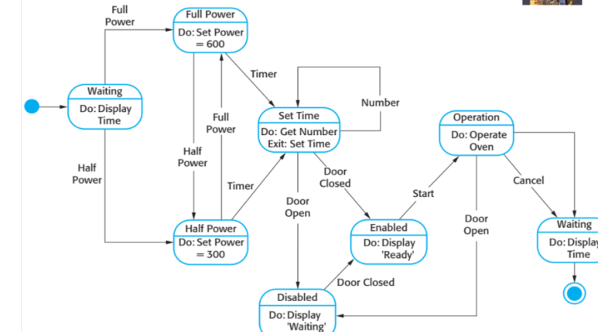
User waiting
User waiting
Do:User1 add
operation
Do:user
operation
number
User waiting
Set time
cancel
waiting
User waiting
Exit:Set time
start
Do:user add
User closed
waiting
Do:User added
timer
User open
enable
Do:user add
User waiting
User closed
User waiting
disable
Do:User2 add
Do:user not
add

Slide 34
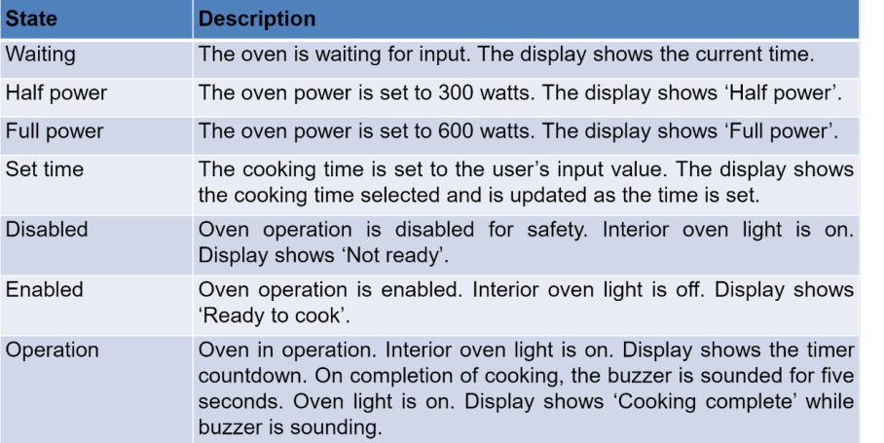
State | Description
Waiting | User loading
User waiting | New user add
Set time | user's usage time
Disable | user information control not active
Enable | user information control active
Operation | user information control

Slide 35
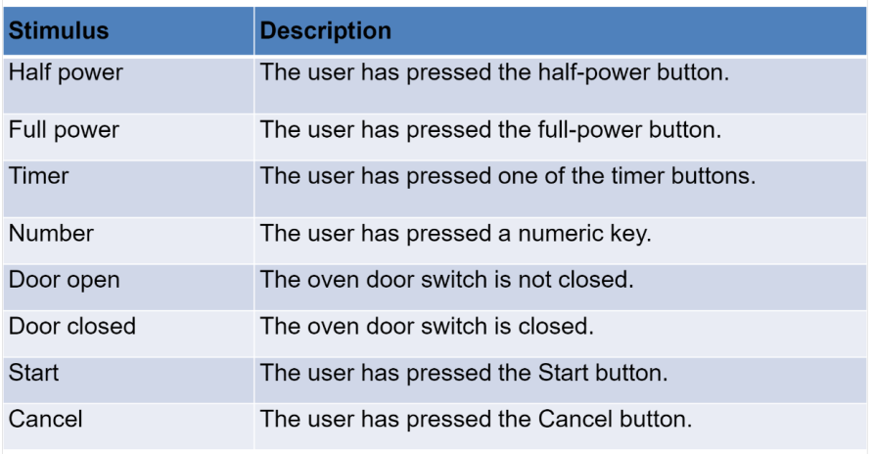
Stimulus | Description
User waiting | User has pressed the user waiting.
Timer | User has pressed one of the timer button.
Number | Number of users
User open | User active
User closed | User not active
Login | User has pressed the login buton.

Slide 36
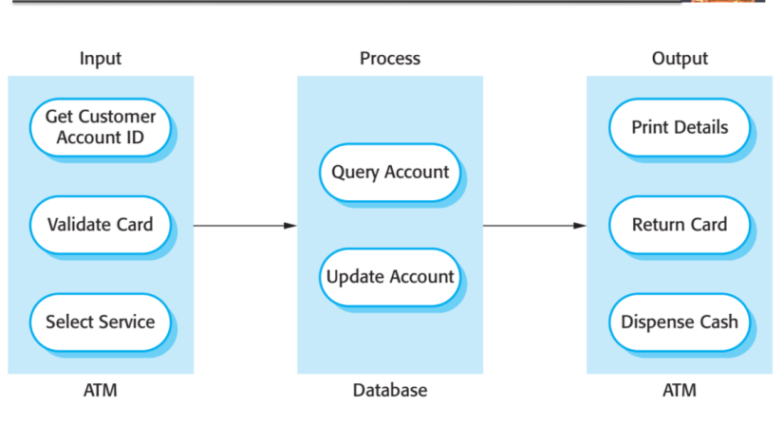
Input
Process
Output
User
Print User
User Account
Have a user
Return User
Update Account
Select Login
User Remove
Form
Database
Form

Slide 37
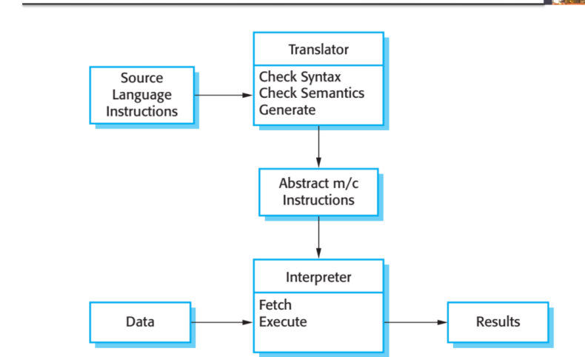
No Translator because language english
Translator
Source Language Instructions
-have a username and password
User name
Password
Execute
Interpreter
Access
Login

Slide 38
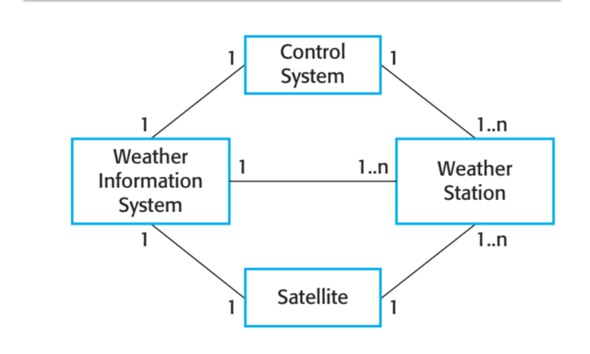
Access
1
1
1.n
1
Student Add
Parents Add
1.n
1
1
1.n
Visual Studio
1
1

Slide 39
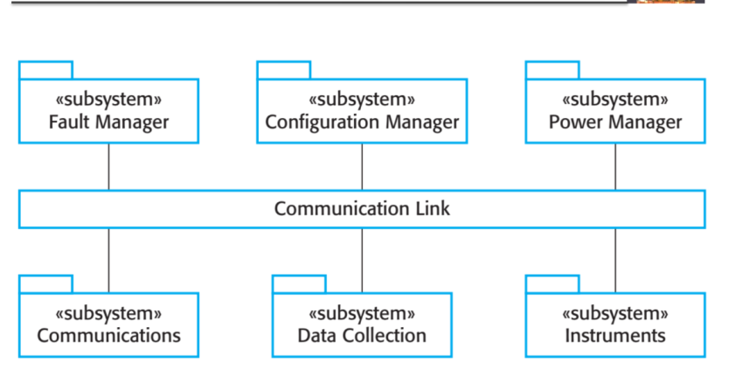
User
Password
Student
Access
Parents
Parents properties
Student properties

Slide 40
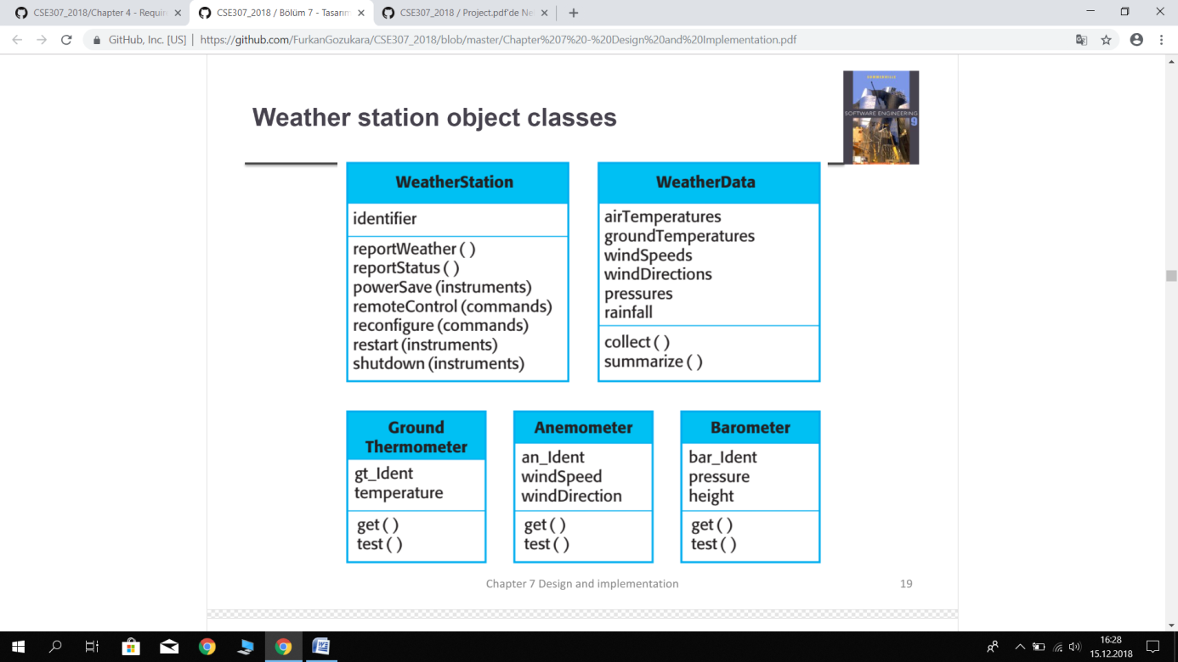
Data(Access)
Microsoft Access
Software Station
-C sharp
Visual Studio
User
-User
-Password
Student
-ID
-Name
-Surname
-Class
-Parents Name/Surname
-ID
-Name
-Surname
-Status
Parent

